Slide 1
Exploring Coffee Quality Data with Power BI About Dataset- Power BI
By Mounika

Slide 2
INTRODUCTION
Coffee Quality Institute(CQI) is a Non- profit organization founded in 1996, headquartered in California, USA.
CQI’s mission is to improve coffee quality worldwide through research, training and certification.
Works with growers, processors, roasters and stakeholders to promote speciality coffee industry.

Slide 3
ABOUT DATASET
Includes data on coffee production, processing, sensory evaluation, genetics and soil.
Sensory attributes evaluated: Aroma, Aftertaste, Acidity, Body, Balance, Uniformity, Clean Cup and Sweetness.
Total Cup points is the sum of the 10 sensory features.

Slide 4
DEFECTS IN COFFEE
Category one defects (visual): Black beans, Sour beans, Insect damage and Fungus damage.
Category two defects (taste): Over-fermentation, Staleness, Rancidness, Chemical taste.

Slide 5
OBJECTIVES
Understand factors contributing to coffee quality.
Key research questions:
1. Key Determinants via sensory attributes?
2. Correlation between processing methods, origin and quality scares?
3. Trends in defects and impact on quality?
4. Variable interactions influencing Total Cup Ponits?

Slide 6
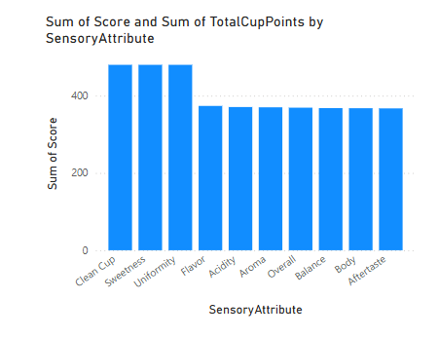
SENSORY ATTRIBUTES ANALYSIS
Based on the analysis, the sensory attributes most strongly correlated with overall coffee quality (Total Cup Points) are Flavor, Aroma, and Balance. These show the highest average values and the strongest positive relationships in scatter plots. Attributes like Clean Cup, Sweetness, and Uniformity also contribute consistently but show less variability.

Slide 7
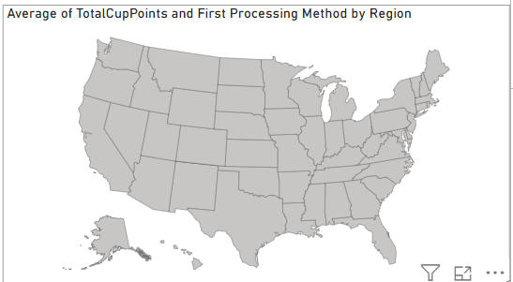
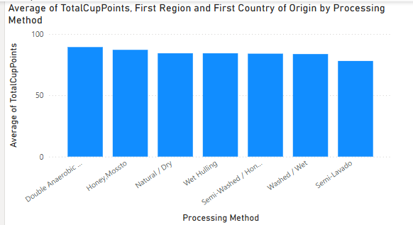
COFFEE QUALITY vs PROCESSING METHODS AND ORIGIN
There is a clear correlation between Processing Method and Total Cup Points. Coffees processed using the Washed method consistently score higher across most countries.
Additionally, regions like Ethiopia, Colombia, and Kenya show high quality scores, indicating that origin region also plays a key role in determining quality.
The Matrix and Map visuals show that some processing methods perform better only in specific regions, suggesting that regional climate, soil, and processing expertise all contribute to overall coffee quality.

Slide 8
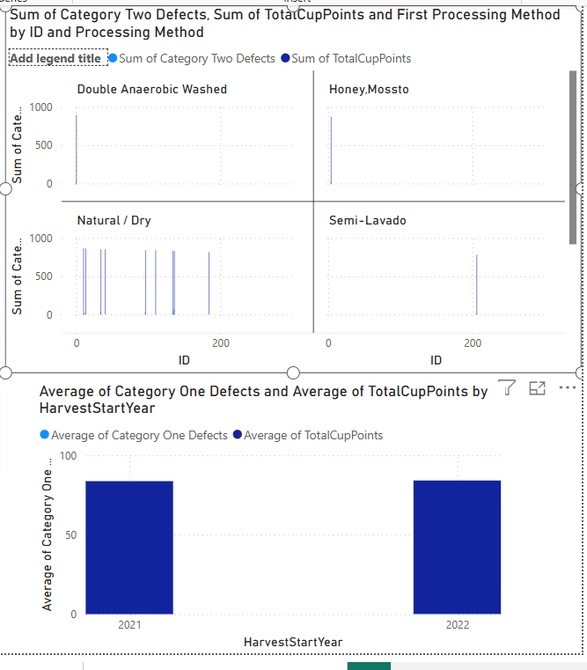
DEFECT TRENDS AND IMPACT ANALYSIS
There is a clear negative correlation between defects and Total Cup Points.
As Category One and Category Two defects increase, the overall quality score drops significantly.
This is visible in the scatter plots, where high-defect samples cluster in the lower score range, and in bar charts where defect buckets with more issues average lower cup scores.
The matrix also reveals that certain regions or processing methods may be more prone to defects, hinting at quality control or environmental challenges.

Slide 9
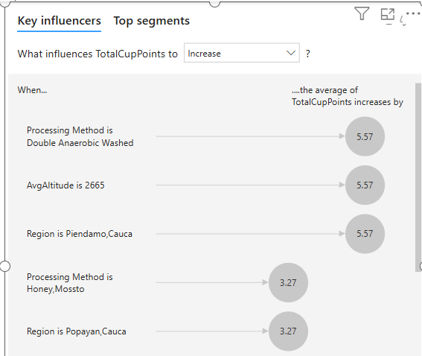
INTERACTION EFFECTS ON TOTAL CUP POINTS
Flavor, Aroma, Balance, and lower defect counts are the strongest drivers of high Total Cup Points.
Washed processing, high altitude, and certain countries also contribute to better coffee quality.

Slide 10
CONCLUSION
Summarize key findings from the analyses.
Recommendations for improving coffee quality
Potential next steps or future research.

